Slide 1
PROJECT Big Data Analytics with Hadoop and R
Rajeshreddy Desham Studentid:1682826

Slide 2
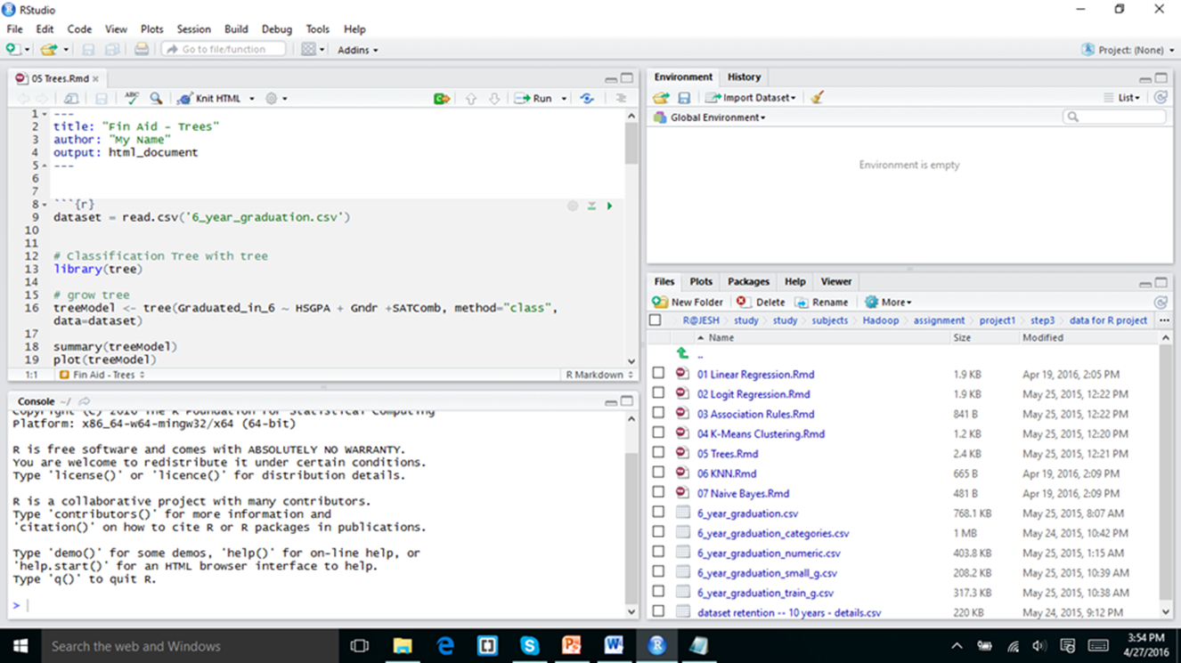
RSTUDIO
I installed the R and Rstudio and I downloaded the data for R project from the web campus and downloaded it and keep it as the home folder for R studio Now I downloaded the specific Rmd script from folder and for my id it is 05 Trees.Rmd

Slide 3
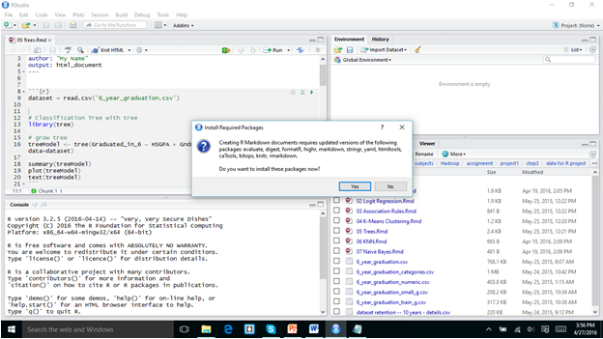
In the Above slide show what packages I installed evaluate digest formatR and highr markdown and stringr.

Slide 4
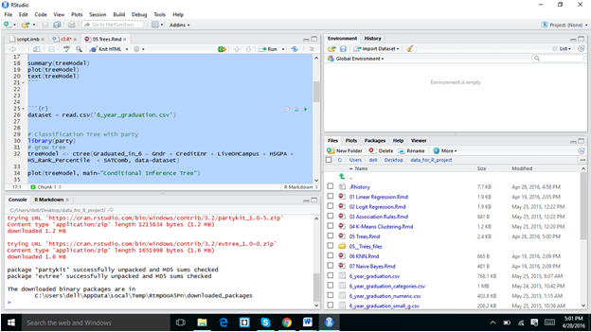
In the above screen shot I used some other packages and I successfully run it

Slide 5
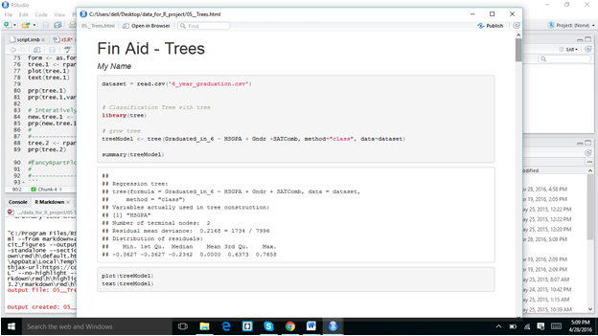
Below is output of screen shots.

Slide 6
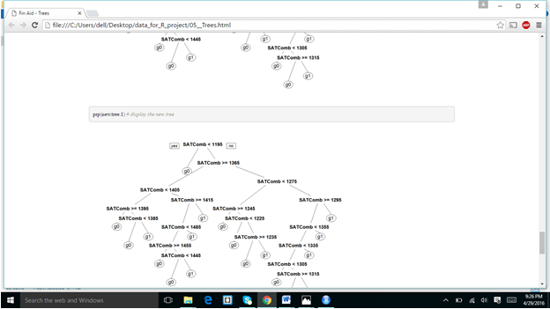

Slide 7
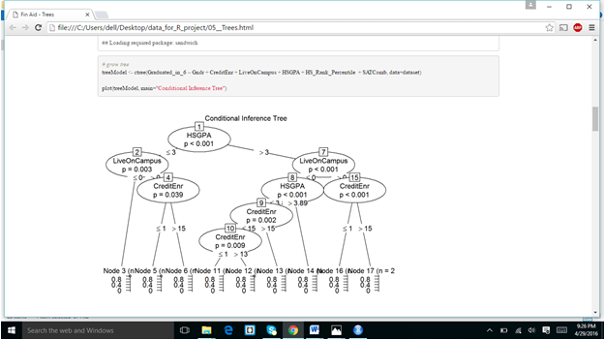
ANSWERS FOR THE QUESTION NO 8:
Decision trees datamining method.
supervised method.
Data Set which my script used is:6_year_graduation.csv file
I installed evaluate digest formatR and highr markdown and stringr packages,Tree library.

Slide 8
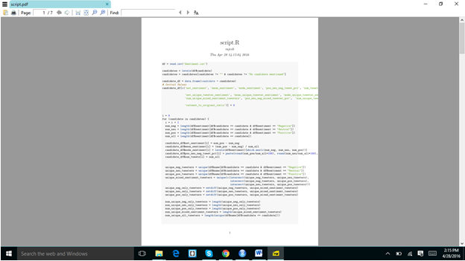
I sign up for the kaggle .com and I downloaded the script from the given
I downloaded the R script from given Link and I kept the script in the home location and I RUN the script.I got the below results in pdf form

Slide 9
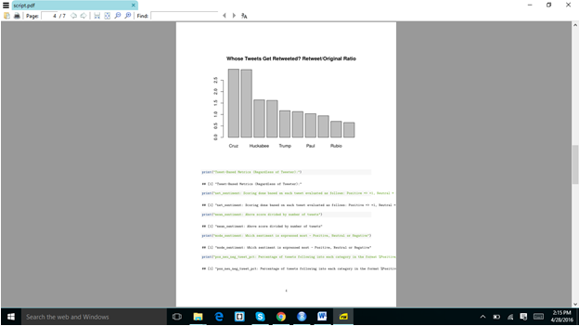

Slide 10
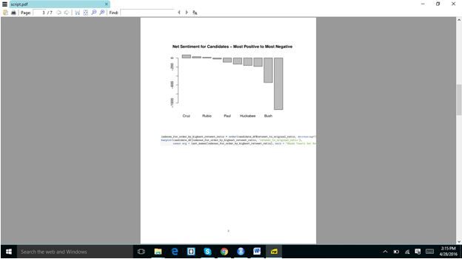

Slide 11
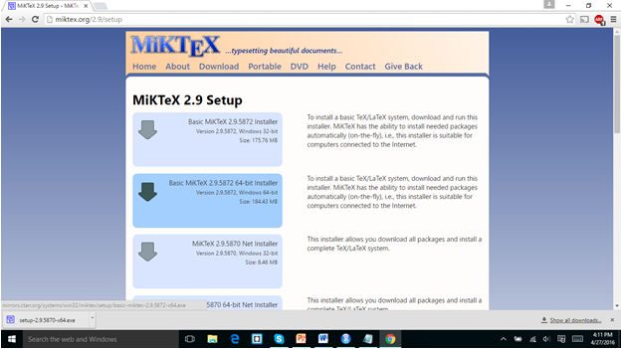
I got the results in pdf because I downloaded and install theMiktex

Slide 12
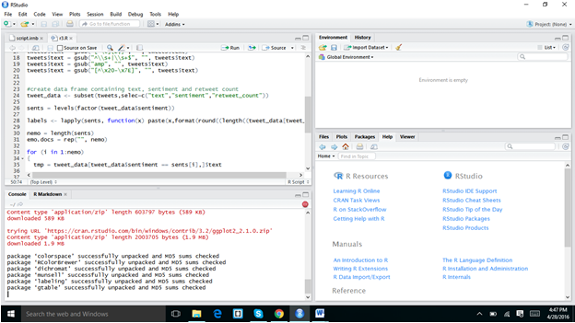
ASSIGNMENT 3 EXTRA CREDIT:

Slide 13
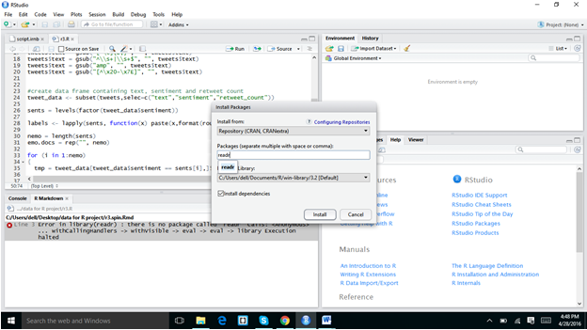
In the above screen shot I downloaded the readr package and I installed some more packages in below screen shot

Slide 14
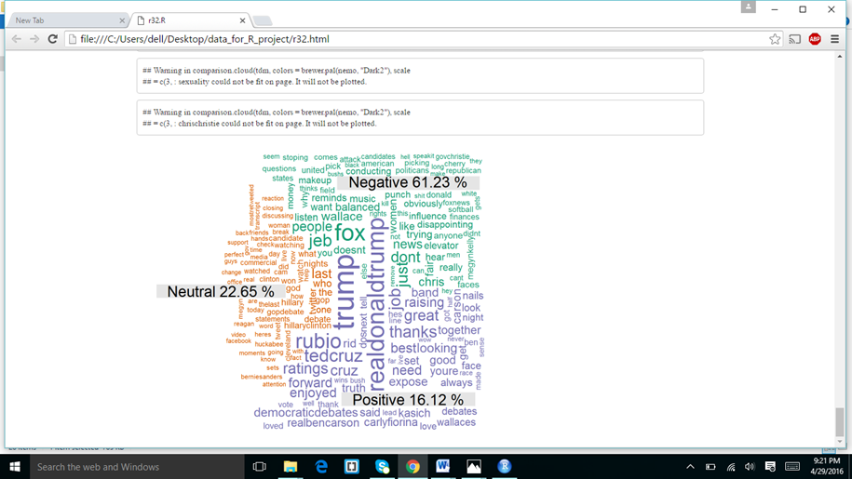
I got the below results

